Slide 1
Overview And Capabilities

Slide 2
Contents
  ^{Meet The Team}
  ^{Strong History}
  ^{Coverages}
  ^{Key Points}
  ^{Questions}

Slide 3
Meet The Team
FOP Legal Defense Plan Team
^{Legal Defense Plan Board}
^{Steve James, President (CA)}
Pete Fogarty, Vice President (KS)
^{Robert Martin, Treasurer (CT)}
^{Dave Mutchler, Secretary (KY)}
^{Jerry Wright (SC)}
^{Tony Harrison (SD)}
^{Bill Albertson (MO)}
^{Hylant- Enrollment/Marketing}
^{Michael Yon}
^{Amy Nolen}
^{Maureen Jagos}
^{Lynn Young}
^{Martha Stephens}
^{Sedgwick Claims}
^{Management Services}
^{Mimi Sewell}
^{TyRhonda Byrd}
^{Legal Counsel}
^{Pat Fioretto}
Accounting and Audit - Sassetti
^{Jim Robbs}
^{Izabela Poludniak}
Tom Vasey- Merlinos $ Associates

Slide 4
Enrollment & Marketing
Administrator
Hylant
Responsibilities include:
Marketing and increasing Plan membership
Enrollment administration – process applications and fee distributions, invoicing, adding and deleting, cancellations and changes
Communications with active and potential new members – responding to questions and concerns
Consultant and advisor to the Board

Slide 5
Claims ADMINISTRATOR
Sedgwick
Responsibilities include:
Providing dedicated claims services for the FOP Legal Plan
Interpreting the Plan Description as guided by Board
^{DETERMINING COVERAGE}
MAINTAINING the PLAN ATTORNEY PANEL
^{PAYING ATTORNEY INVOICES}
Experience and expertise with law enforcement cases

Slide 6
Strong
History
“It’s better to have it
and not need it, than to need it and not have it.”

Slide 7
Legal Plan History
Sponsored by the FOP Grand Lodge and operated by the FOP Legal Plan, Inc. since 1995.
Currently over 109,000 active participants.
The Plan has serviced over 42,000 claims and paid out over $102 million in legal fees defending participants.

Slide 8
What makes this plan strong
Sponsored by the FOP Grand Lodge and operated by the FOP Legal Plan, Inc. –
^{This is your Plan!}
Must be an active FOP member to participate
Choice of your own attorney with legal
^{fees paid on your behalf}
^{Financially Strong}
^{Catastrophic Excess Insurance}
FOP Legal Plan Board of Trustees whose purpose is to:
    Provide management and fiduciary oversight
    Address coverage appeals on behalf of fellow officers
    Monitor the performance of the Plan
    Responds to the changing needs of Plan participants and Plan solvency

Slide 9
Additional strengths
^{One price nationwide –}
^{NOT experience rated}
Protects personal assets and professional reputations
Sends a message that you have a
^{strong defense partner}
Deters frivolous administrative actions
Protects you and your organization from
^{crippling legal defense fees}
Specifically addresses the legal defense
^{needs of police professionals}

Slide 10
Coverages

Slide 11
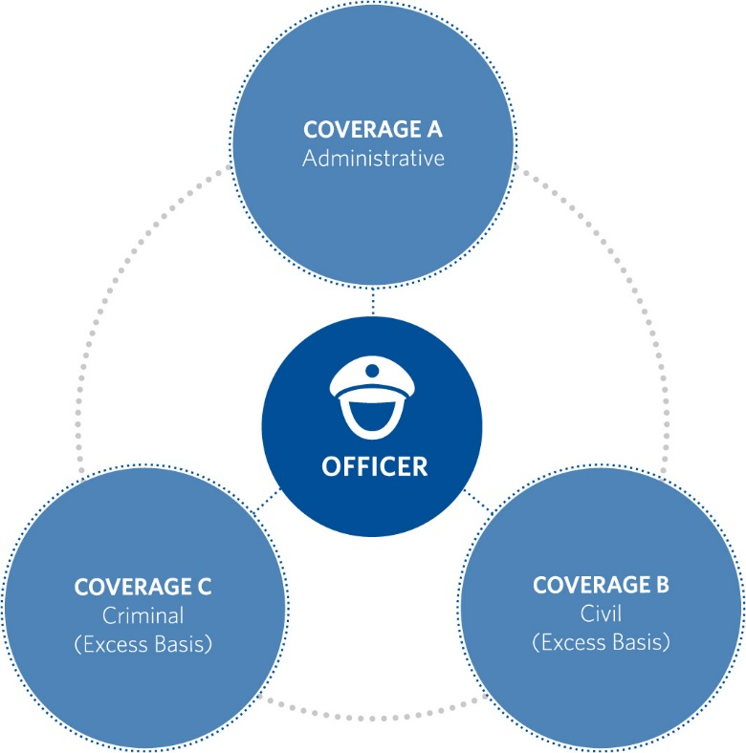
Legal Plan
Unlimited Coverages
WHEN PARTICIPANT USES A Plan Attorney
The Plan pays legal defense costs on your behalf arising out of the following actions and procedures:
Administrative (on-duty and off-duty)
Civil (excess-employer is primary)
^{Criminal}
Civil Monitoring available when employer provides Civil coverage
^{On Duty Covered}

Slide 12
Administrative Coverage
Off-duty out of scope coverage: (Included)
Covers incidents that occur off-duty and not within the scope of employment which result in administrative discipline or sanction. (DUI, Domestic, etc.)
Covers administrative discipline or sanction only, not any related civil or criminal lawsuit.

Slide 13
Enhanced Coverages
^{Salary Reimbursement Options} | ^{Civil Monitoring} | ^{Fire Department coverage} | Private College/University, Private Railroad, ^{or Native American} ^{Tribal Government}
In lieu of Legal Defense costs, participants whose claims involve suspension or other discipline resulting in salary loss may elect to receive reimbursement of up to (3) days actual salary loss. May be utilized once per year. | There may be situations in which a defense attorney is being provided through “another plan, your employer, or insurance,” but the obligation to provide such services is limited in scope. Under those circumstances the Plan will now provide monitoring coverage when you select a Plan attorney only. | This coverage is for FOP associate members employed by a federal, state or local government fire department whose part-time or full-time duties include arson investigation. The members must be certified peace officers with powers of arrest and have current firearms certification. Eligible for civil/criminal coverage, not administrative. | If only employed by law enforcement entity and certified to carry a firearm may participate in the administrative and criminal coverage.

Slide 14
Retired Concealed Carry Coverage - New
^{Replaced HR-218}
Included in the regular Legal Defense Plan coverage.
Coverage available to only retired law enforcement officers in good standing with the FOP.
Covers concealed carry- charges; legally carrying a concealed firearm or carrying such firearm in one’s own home or vehicle at the time of the incident giving rise to any claim.
Provides coverage for retirees who were qualified under LEOSA, but also those retirees who are qualified under their own state laws to carry a concealed weapon.
Unlimited Legal Defense for civil and criminal claims associated with the legal carrying and/or use of a concealed weapon: all reasonable and necessary Legal Defense Costs are now covered in full when using a plan attorney.
Total annual cost - $75.00 per participant.

Slide 15
Plan Eligibility
Must be active FOP member in good standing
Employment with federal, state or local governmental law enforcement agency
May also include as Participants FOP associate members who are not eligible to be active members and who are in Employment with federal, state or local government law enforcement agency, at the Board’s discretion
^{Individuals}
Groups – at least 50 FOP active members in the lodge, or lesser number of FOP active members equal to at least 50% of the active members

Slide 16
Coverage Effective
Coverage effective dates are the first day after the application is approved and payment received by Hylant. Applications not fully and accurately completed may result in ineligibility for, and non-payment of benefits.
Participants can be added to Legal Defense PENDING their National FOP number.
Lodge Groups Enrollment
When a member is sworn into the Lodge/pays for Legal Defense, immediately add member via client portal, in the FOP ID# field type the word PENDING.
Individuals
Complete online application in the FOP ID# field type the word PENDING.

Slide 17
Coverage Effective
Coverage effective dates are the first day after the application is approved and payment received by Hylant. Applications not fully and accurately completed may result in ineligibility for, and non-payment of benefits.
Associate Participants can be added to Legal Defense PENDING their National FOP number.
Lodge Groups Enrollment
When a member is sworn into the Lodge/pays for Legal Defense, immediately add member via client portal, in the FOP ID# field type the word ASSOC.
Individuals
Complete online application in the FOP ID# field type the word ASSOC.

Slide 18
ANNUAL Enrollment & Fees
Per Member
^{Group Rates} | Full Coverage – Administrative, Civil and Criminal | ^{$ 324.00}
 | Two Coverages – Civil and Criminal together | ^{$ 72.00}
^{Individual Rates} | Full Coverage – Administrative, Civil and Criminal | ^{$ 324.00}
 | Two Coverages – Civil and Criminal together | ^{$ 72.00}
^{Payment Options} | Group – Annual, Semi-Annual, and Quarterly
 | Individual – Annual and Semi-Annual
Retired Concealed Carry Coverage | Total Annual Cost – Civil and Criminal | ^{$ 75.00}

Slide 19
2023 Participant Fees
At the conclusion of the Plan’s biannual actuarial study, the Board of Directors for the FOP Legal Defense Plan adopted the following participant fee changes, effective on your renewal date on or after January 1, 2023.
The Board has decided to eliminate the individual pricing tier. With over 90% of our membership belonging to groups, it is no longer cost-effective to administer the individual pricing for such a small segment of our membership. Individuals will now pay the discounted group rate. This will continue to allow the Plan to provide outstanding coverage at the best value in the industry. The following annual pricing is for all Participants in the Legal Defense Plan:
Full Coverage (ABC): $324
Civil/Criminal Coverage (BC): $72
We understand this change could create uncertainties for some Group Administrators as to why they should remain in the Group Plan. Below are just a few of the advantages of a group.
Members perceive great value in the fact that your Lodge/group facilitates their legal defense coverage.
As a Group Administrator, you have the ability to ensure your Lodge Participants are properly enrolled and do not have a lapse in coverage.
24/7 access to an online portal to manage memberships / make payments.
Members can be added immediately with payment billed on the next installment.
Group Administrators continue to maintain control with management of the Plan.

Slide 20
Group/Lodge
Management
Client Portal Access – Groups/Lodges
Add, delete and edit group’s participation roster
^{View account statement}
Update contact information for group/lodge
^{ACH Payment Option}
^{No cost to enroll}
^{Ease of use for payments}
Avoid unintentional lapse in coverage
Group/Lodge Officer/Primary Representative: Call 1-800-341-6038 for more information about enrolling in these benefits
Notes:
Announce new system, Go-Live Date,

Slide 21
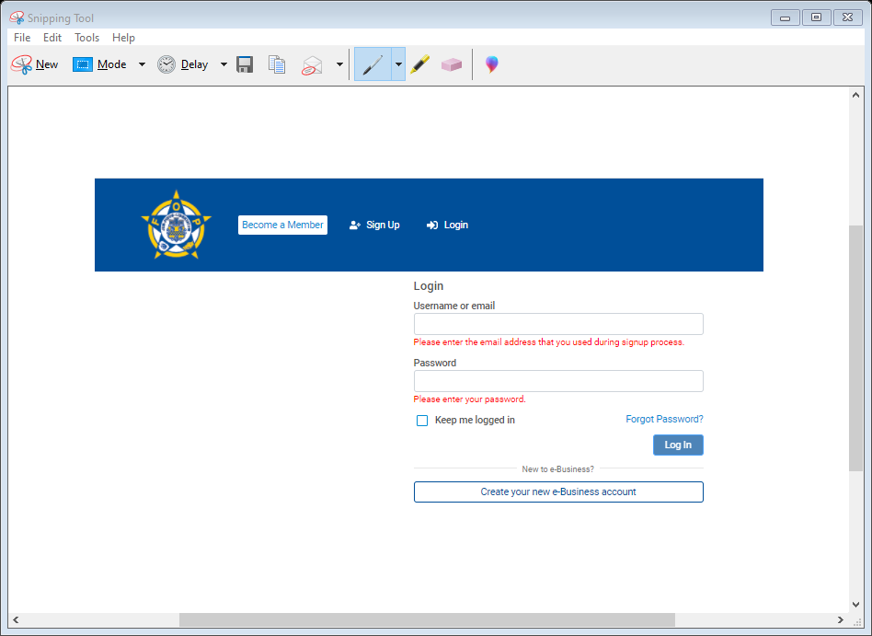
New Client Portal
Lodge Groups
Improve efficiency, functionality, and management of your Legal Defense Plan.
Conveniently make changes online at anytime.
Easily add/remove members and update personal contact information, view memberships.
  View prior payment history.
  Lodge Directory
  Online bill pay.
  Electronic notifications.
Ability to add more than one Lodge Administrator to the account.

Slide 22
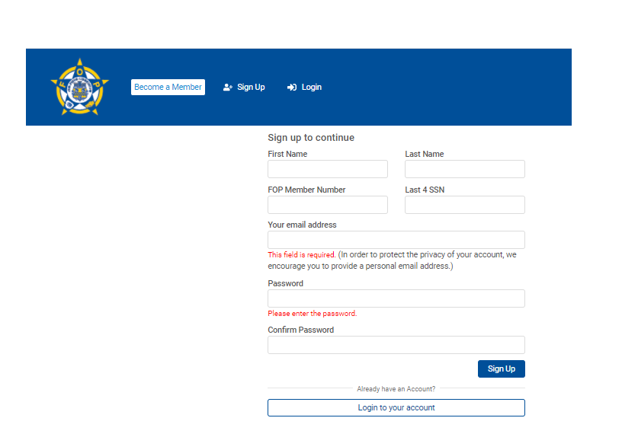
New Client Portal
Individual Participants
To enroll, sign up online.
Conveniently update personal contact information at anytime.
View membership, coverage type/effective day.
Electronic notifications.
Online bill pay.
View previous payment and order history.

Slide 23
Lodge Administrator
Responsibilities
Up to date and accurate rosters – Imperative
Pending New FOP Memberships – Timing
Backdating Requests – Process and Fees
System Enhancements 2021

Slide 24
FOP Legal Plan
Summary

Slide 25
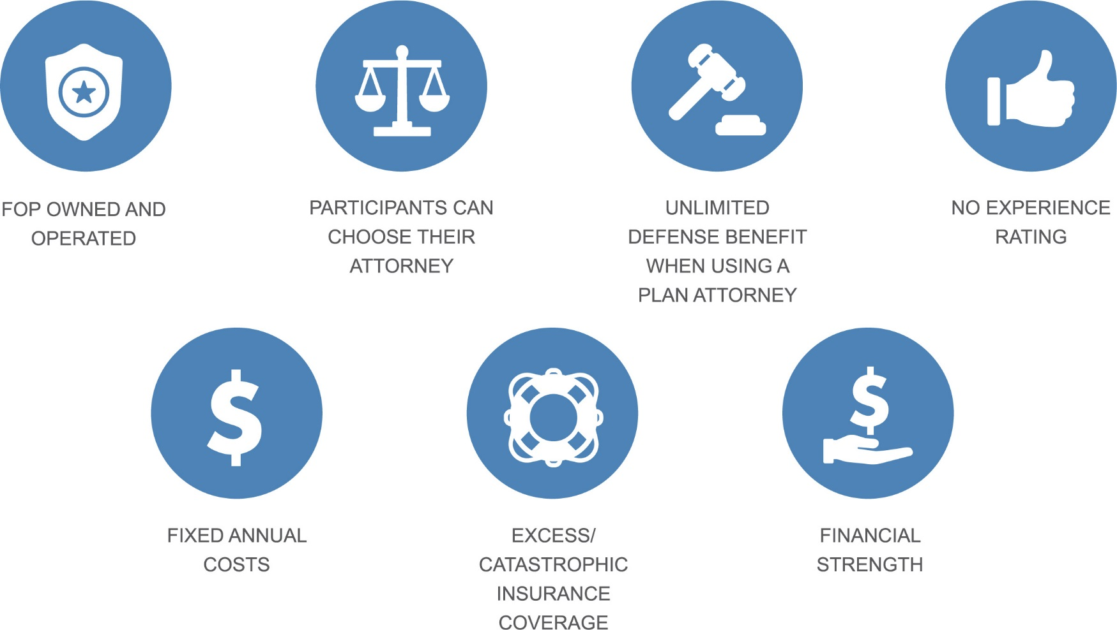
Key Points
Notes:
Do we want to move this slide?

Slide 26
Differentiators
^{Attorney of your choice.}
Off-duty administrative coverage included at no extra charge.
Rates fixed; not increased based on utilization.
^{Letters of reprimand covered.}
Plan benefits do not end when coverage ends.
Extended Reporting Period for reporting claims after Plan participation ends - Unlimited (NEW)

Slide 27
Claims Administration

Slide 28
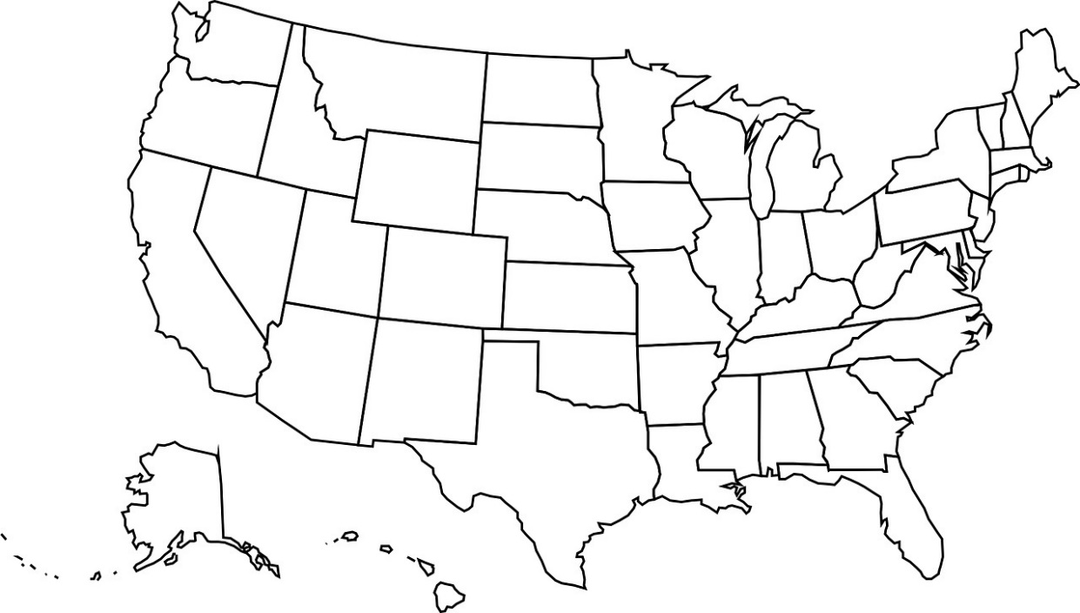
Examples of Covered Claims
Utah
OIS (Admin/Criminal), $120K spent - dismissed
North Dakota
Auto accident/on duty (Criminal/Admin)
$63K spent
Illinois
Abuse of Authority (Criminal) $101k spent
Ohio
Conduct unbecoming (Criminal/Admin)
Over $32K spent to-date
Oregon
Untruthfulness (Admin)
$45K spent
New Jersey
Fitness for duty/Termination (Admin)
$289K spent
California
Fitness for Duty (Admin), $165K spent
Kentucky
Sexual misconduct/on-duty (Criminal),
Over $125K spent to-date
Colorado
Use of Force (Admin/Civil), $175K spent
North Carolina
Use of force (Criminal)
Over $40K spent to-date
Tulsa, OK
Falsifying Documents (Admin/Criminal), Over $1M spent, federal case involving multiple officers
OIS (Criminal), Over $420K spent,
NOT GUILTY verdict
Tennessee
OIS (Criminal),
Over $1.5M spent
Kansas
High speed vehicle pursuit/termination (Admin)
$144K spent
New Orleans, LA - Danziger Bridge
OIS (Criminal),
Over $850K spent

Slide 29
Claims Procedures
^{24/7 number (1-866-857-3276)}
Completed claim form – submitted to Sedgwick through the Plan’s website www.foplegal.com
Include all supporting documents associated with claim
Using Plan attorney or non-Plan attorney? If using non-Plan attorney, subject to $250 deductible per claim and $10,000 cap on benefits.
^{Appeal process}

Slide 30
Who To Call
^{Enrollment & Marketing} ^{Information} | ^{Hylant} ¹⁻⁸⁰⁰⁻³⁴¹⁻⁶⁰³⁸ ^{info@foplegal.com}
^{Claims Service &} ^{Attorney} ^{Qualification} | Sedgwick Claims Management Services ¹⁻⁸⁶⁶⁻⁸⁵⁷⁻³²⁷⁶ ^{foplegal@sedgwick.com}

Slide 31

FOP Legal Plan Website
FOPLegal.com
24/7 access to individual and group applications
Access to claim reporting forms and the Plan attorney panel
^{Online Payment}
Latest FOP Legal Defense Plan news and updates
Client Web Portal access for group membership and lodges

Slide 32

Don't forget

Slide 33
Questions

